Slide 1



Understanding the New NIH Data Management & Sharing Policy
CONVERSATIONS WITH NIH
Webinar Series – Part 1
Understanding the New NIH Data Management and Sharing (DMS) Policy
August 11, 2022
Hosts:
NIH Office of Extramural Research (OER)
NIH Office of Science Policy (OSP)

Slide 2
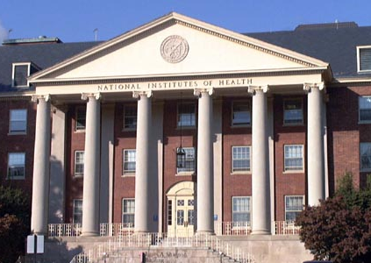
NIH has a longstanding commitment to making the results of research available.
Data Management and Sharing Policy will create a consistent minimum expectation for all research supported by agency.

Slide 3

DMS Policy: Scope
Applies to all research, funded or conducted in whole or in part by NIH, that results in the generation of "scientific data“.
"Scientific data" is defined as:
  "the recorded factual material commonly accepted in the scientific community as of sufficient quality to validate and replicate research findings, regardless of whether the data are used to support scholarly publications."

Slide 4
Potential Examples of Scientific Data
Scientific data will vary depending on the
project and the context.
Scientific data might include:
Single-cell RNA sequencing (scRNA-seq) of T lymphocytes or other immune cells in a study of HIV/AIDS
Electrophysiological recordings and fMRI images in a study of a rodent model of PTSD
Step activity from a wearable device in a study of cardiovascular health

Slide 5
Exclusions from the DMS Policy
Scientific data do
not include:
  Data not necessary for or of sufficient quality to validate and replicate research findings,
  Laboratory notebooks,
  Preliminary analyses,
  Completed case report forms,
  Drafts of scientific papers,
  Plans for future research,
  Peer reviews,
  Communications with colleagues, or
  Physical objects, (e.g., laboratory specimens)

Slide 6
Activities Subject to the DMS Policy
APPLIES TO…
All research generating scientific data, including but not limited to:
Research Projects
Certain Career Development Awards (Ks)
Small Business SBIR/STTR
Research Centers
DOES NOT APPLY TO…
research projects not generating scientific data or non-research projects, including but not limited to:
Training (Ts)
Fellowships (Fs)
Certain non-research Career Awards (e.g., KM1)
Construction (C06)
Conference Grants (R13)
Resources (Gs)
Research-Related Infrastructure Programs (e.g., S06)

Slide 7
Policy Effective Dates
The DMS Policy applies to all NIH funding mechanisms
Extramural | Competing applications submitted for Jan 25, 2023, and subsequent receipt dates - Non-competing awards will not immediately become subject to Policy
Contracts | Proposals submitted on or after Jan 25, 2023
Intramural | Projects conducted on or after Jan 25, 2023
Other funding agreements (e.g., Other Transactions) | Executed on or after Jan 25, 2023, unless otherwise stipulated by NIH

Slide 8
Policy Requirements
  Submission of Data Management & Sharing Plan with all applications for funding beginning January 25, 2023
  Compliance with the Data Management and Sharing Plan approved by the funding NIH Institute, Center, or Office

Slide 9
Limitations on Sharing
DMS Plans should maximize appropriate sharing
  Justifiable ethical, legal, and technical factors for limiting sharing include:
    Informed consent will not permit or limits scope of sharing or use
    Privacy or safety of research participants would be compromised and available protections insufficient
    Explicit federal, state, local, or Tribal law, regulation, or policy prohibits disclosure
    Restrictions imposed by existing or anticipated agreements with other parties

Slide 10
Limitations on Sharing:
Other Considerations
  Reasons NOT generally justifiable to limit sharing:
    Data are considered too small
    Researchers anticipate data will not be widely used
    Data are not thought to have a suitable repository

Slide 11
Elements of a DMS Plan
Plan Elements
Data Type
Related tools, Software and/or Code
Standards
Data Preservation, Access and Associated Timelines
Access, Distribution, or Reuse Considerations
Oversight of Data Management and Sharing
Data type
  Identifying data to be preserved and shared
Related tools, software, code
  Tools and software needed to access and manipulate data
Standards
  Standards to be applied to scientific data and metadata
Data preservation, access, timelines
  Repository to be used, persistent unique identifier, and when/ how long data will be available
Access, distribution, reuse considerations
  Description of factors for data access, distribution, or reuse
Oversight of data management and sharing
  Plan compliance will be monitored/ managed and by whom
See Writing a Data Management & Sharing Plan for details

Slide 12
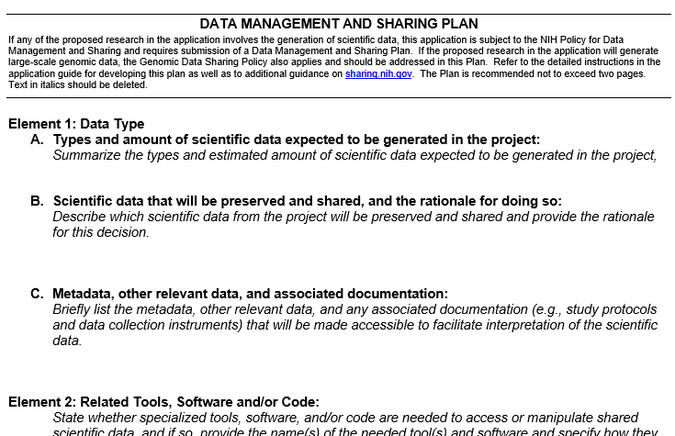
Format of a DMS Plan
Plans should be no more than 2 pages in length
Optional format page will be available
DMS Plan format page will be added to list of Format Pages and incorporated into FORMS-H application instructions by Fall 2022

Slide 13
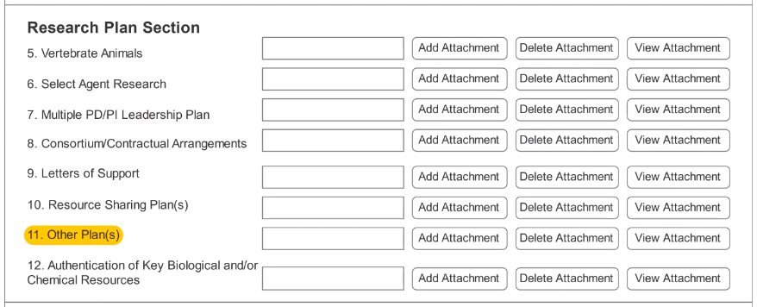
DMS Plan Submission
A new “Other Plan(s)” field will be added to the PHS 398 form to collect a single PDF attachment
Data Sharing Plans and Genomic Data Sharing Plans will no longer be submitted to the “Resource Sharing Plan(s)” field

Slide 14
Sharing Data
Encourages use of established repositories
Depositing data in a quality repository generally improves the FAIRness of data – Findable, Accessible, Interoperable, Reusable
NIH ICs may designate specific data repository(ies)
See Selecting a Data Repository for details

Slide 15
Finding and Selecting a Repository:
Desirable Characteristics for All Data Repositories
Unique Persistent Identifiers
Long-Term Sustainability
Metadata
Curation and Quality Assurance
Free and Easy Access
Broad and Measured Reuse
Clear Use Guidance
Security and Integrity
Confidentiality
Common Format
Provenance
Retention Policy

Slide 16
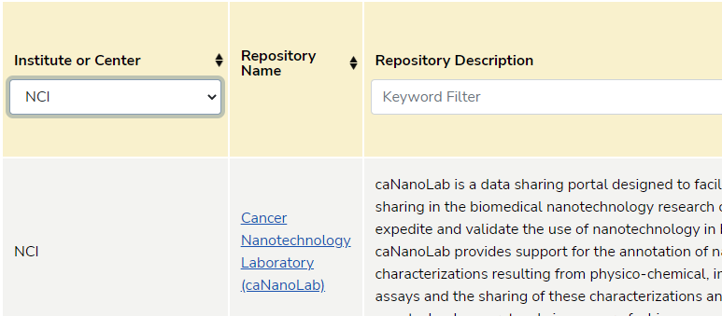
Finding and Selecting a Repository:
NIH & Other Resources
NIH-Supported Repositories
Other Repository Resources
Filterable list of 70+ NIH Repositories
Generalist repositories
Nature's Data Repository Guidance
Registry of Research Data Repositories
See Repositories for Sharing Scientific Data

Slide 17
When should I share my data?
As soon as possible!
No later than the time of a publication of findings in a peer-reviewed journal OR at the end of the award, whichever comes first
Sharing
Collection
Analysis/ Curation
Storage
Access/ Archive

Slide 18
For how long should data be shared?
Not one size fits all. Appropriate time frame varies across disciplines.
Consider relevant requirements and expectations:
  Data repository policies
  Award record retention requirements
  Journal policies
Sharing
Collection
Analysis/ Curation
Storage
Access/ Archive
Notes:
SLIDE M

Slide 19
Data Management and Sharing Costs
ALLOWABLE COSTS:
Curating data/developing supporting documentation
Preserving/sharing data through repositories
Local data management considerations
IMPORTANT: Must be incurred during the performance period
UNALLOWABLE COSTS:
Infrastructure costs typically included in indirect costs
Costs associated with the routine conduct of research (e.g., costs of gaining access to research data)
See Budgeting for Data Management & Sharing for details

Slide 20
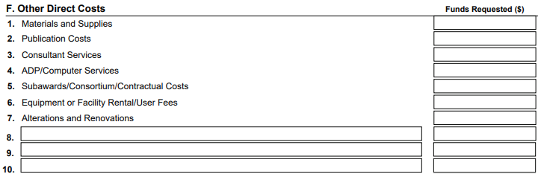
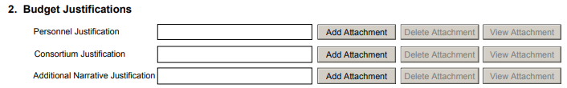
Submitting DMS Budgets
Direct costs to support the activities proposed in the DMS Plan must be indicated as “Data Management and Sharing Costs”
  R&R Budget Form: line item in section F. Other Direct Costs
  PHS 398 Modular Budget Form: within Additional Narrative Justification
Data Management and Sharing Costs

Slide 21
Justifying DMS Budgets
Brief summary of DMS Plan and description of DMS costs must be included within the budget justification attachment
  R&R Budget Form: section L. Budget Justification
  PHS 398 Modular Budget Form: Additional Narrative Justification

Slide 22

DMS Plan Assessment
NIH program staff determine if DMS Plan is acceptable or unacceptable
Peer reviewers ONLY consider if budget is reasonable

Slide 23
Resolving Issues Before Award
DMS Plan must be approved prior to award
If additional details are needed, it may be necessary to communicate with NIH staff to resolve issues with DMS Plan
  Will occur through standard Just-In-Time (JIT) process
  Provide additional information and potentially a revised DMS Plan

Slide 24
Incentives for Good Sharing Practices
Data citation to incentivize data sharing
Shared data can be cited as products of awards and claimed as products of NIH funding
  Data can be cited anywhere other research products are cited, e.g., bibliography, biosketch, progress report
Persistent unique identifiers to help track data reuse

Slide 25
Is the use of a Unique Persistent Identifier (PID) required?
Definition: A Unique Persistent Identifier assigns datasets a citable, unique persistent identifier, such as a digital object identifier (DOI) or accession number, to support data discovery, reporting, and research assessment.
The use of PIDs is encouraged and their use is a desirable characteristic of data repositories.

Slide 26
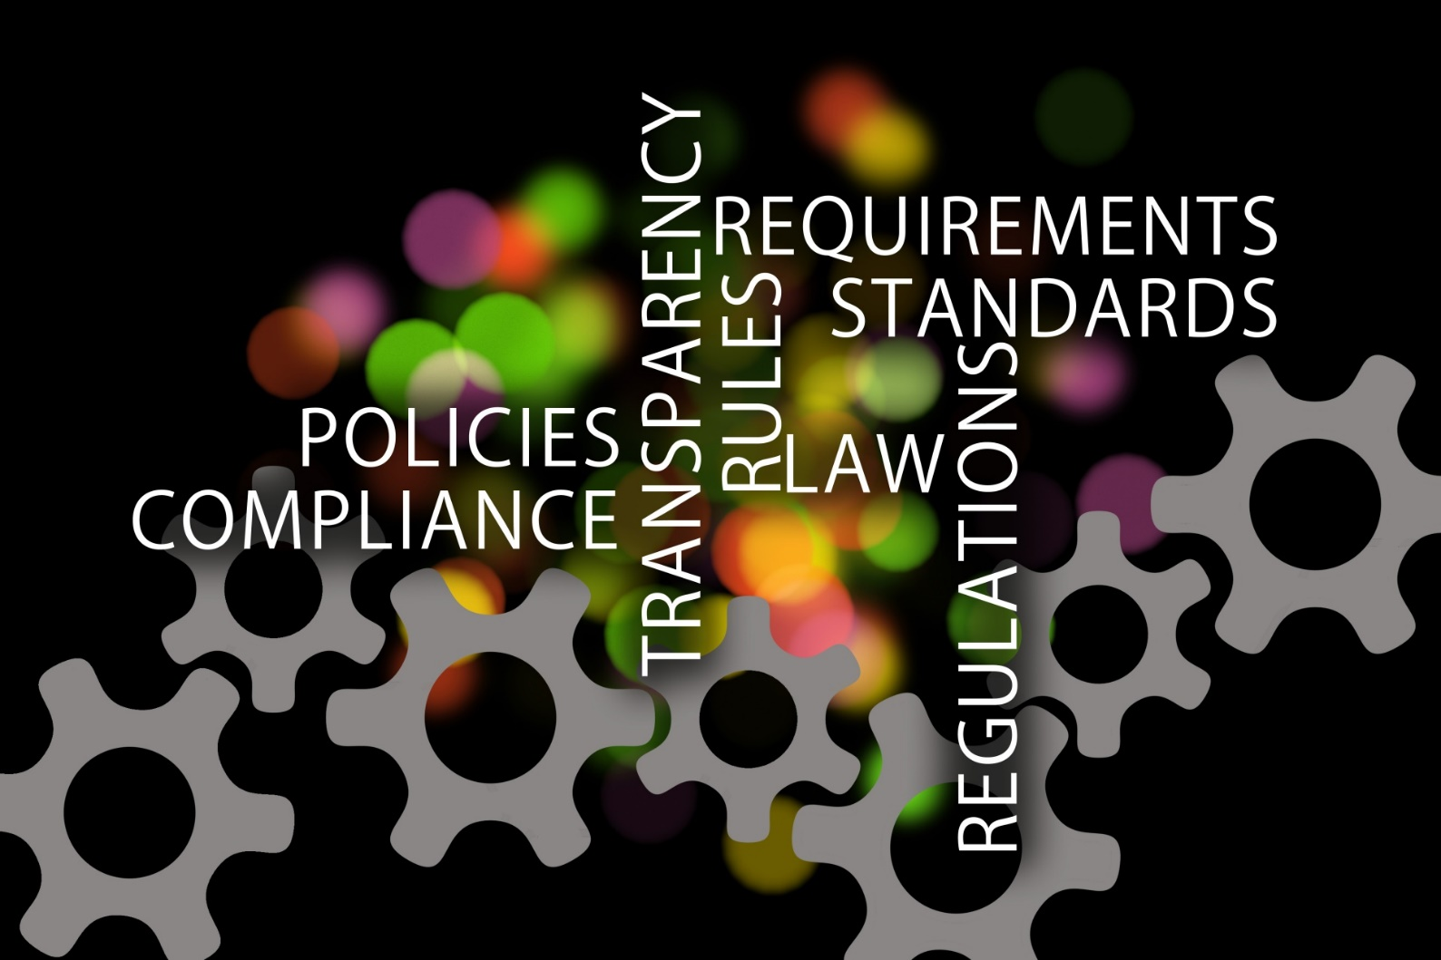
Monitoring Compliance
Approved Plan becomes a Term and Condition of Award
Grantee reports progress of approved DMS Plan in RPPR*
NIH reviews compliance annually
  Failure to comply…. may result in an enforcement action, including additional special terms and conditions or termination of award, and may affect future funding decisions.
*RPPR: Research Performance Progress Report (RPPR) - Annual, Interim, and Final

Slide 27
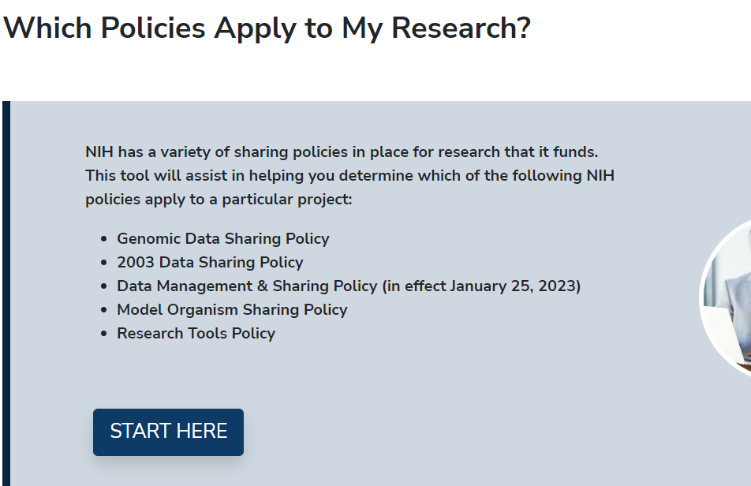
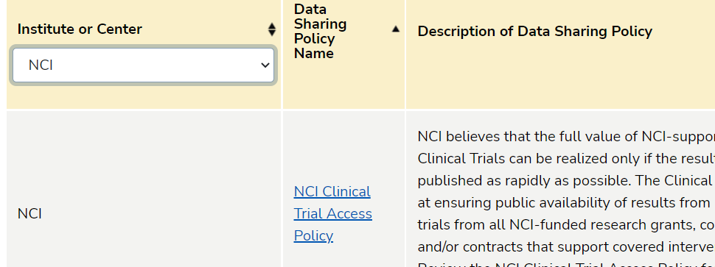
Is my research also subject to other NIH data sharing policies?
DECISION TOOL
NIH INSTITUTE AND CENTER DATA SHARING POLICIES

Slide 28
You Can Prepare Now
Familiarize yourself with the DMS Policy and resources available at sharing.nih.gov
Identify existing resources and expertise within your institution that may be able to assist you, such as data librarians
Try drafting a Data Management and Sharing Plan for your work based on the recommended elements (NOT-OD-21-014)
Review your past data sharing practices to meet other funder or publisher expectations and consider what you may need to update for the new Policy in the future
Get involved: see FASEB DataWorks! for challenges and prizes

Slide 29
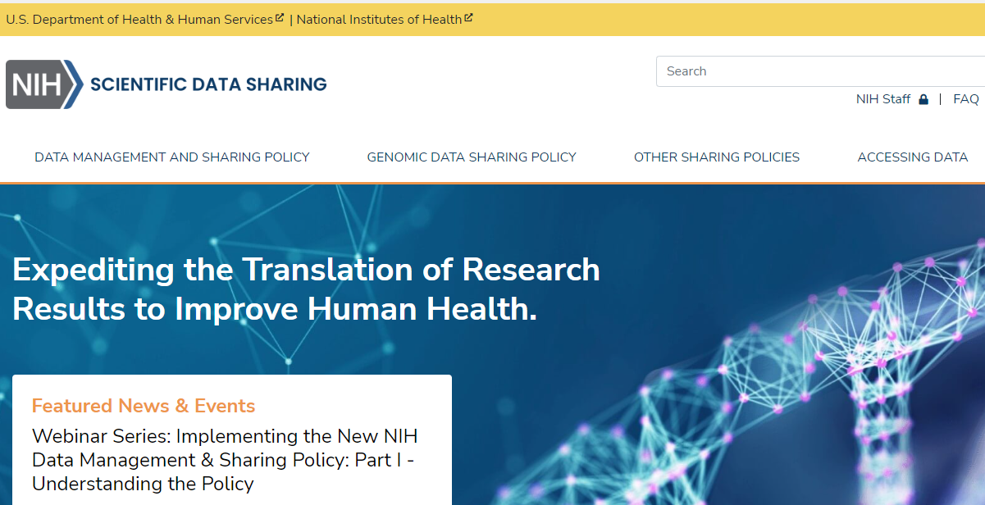
For More Information…
Website: NIH Scientific Data Sharing
FAQs: DMS Policy FAQs
Email Box: Sharing@nih.gov
Webinar Part II: Diving Deeper into the New NIH Data Management and Sharing Policy - September 22

Slide 30

Stay in the loop!
BLOGS
LISTSERVS
SOCIAL MEDIA
Under the Poliscope
Open Mike
Extramural Nexus
NIH Guide to Grants & Contracts
Office of Science Policy News
NIH Scientific Data Sharing News & Events
@NIHGrants
@NIH_OSP

Slide 31

Virtual NIH Grants Conference & PreCon Events
PreCon Events
August 25: NIH Loan Repayment Programs: Supporting the Next Generation of Researchers
September 15: Navigating Early Career Funding Opportunities
October 13: Research Misconduct & Integrity
November 9: Foreign Collaborations: Policies, Processes, & Partnerships
December 6 & 7: Human Subjects: Policies, Clinical Trials, & Inclusion
January 12, 2023 Making the Most of the 2023 NIH Grants Conference
2-Day Conference
February 1 & 2, 2023: 2023 Virtual NIH Grants Conference: Funding, Policies, & Processes
LEARN MORE AT
Grants.nih.gov/learning-center/conference

